Slide 1
CNC Machining Look Ahead to the Next Assignment and Next Semester
MEEG 301
Fall, 2018

Slide 2
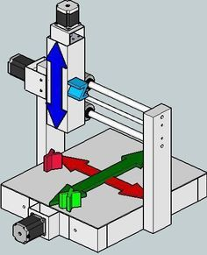
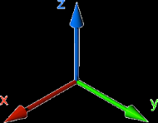
What is CNC Milling?
CNC = Computer Numerical Control
2-axis CNC - Computer controls the movement of the x-y table
3-axis CNC - Computer controls the movement of the x-y table and the z-axis
There are also 4- and 5- axis CNC machines. These concepts can also be applied to lathes, routers, sheet metal fabrication, etc.

Slide 3
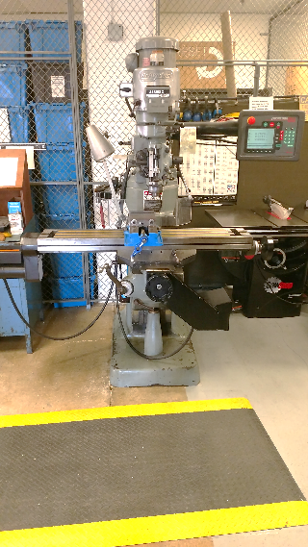
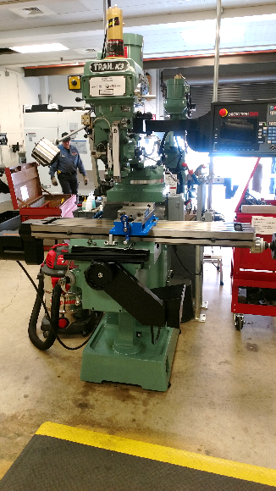
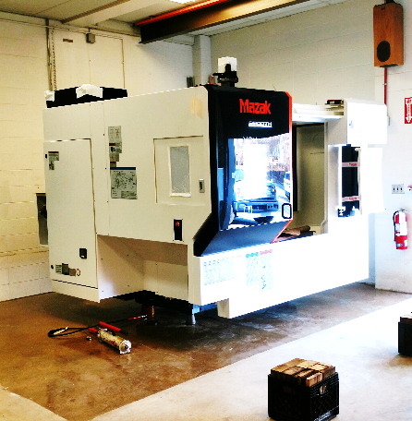
3-axis CNC Mill
(x, y and z control)
Manually Operated Mill
(from last semester)
2-axis CNC Mill
(x and y control)

Slide 4
Differences between the Prototrak and Mazak mills
Trak 2-axis K3 Mill
Mazak VCU-500C 3-axis Mill
3 HP motor
4200 RPM spindle
100 IPM rapid max
2800 lb machine weight
Manual tool changes
25 HP Motor
12000 RPM spindle
1000 IPM max
18000 lb machine weight
30 Tool magazine/ automatic tool changes
Renishaw touch probe

Slide 5
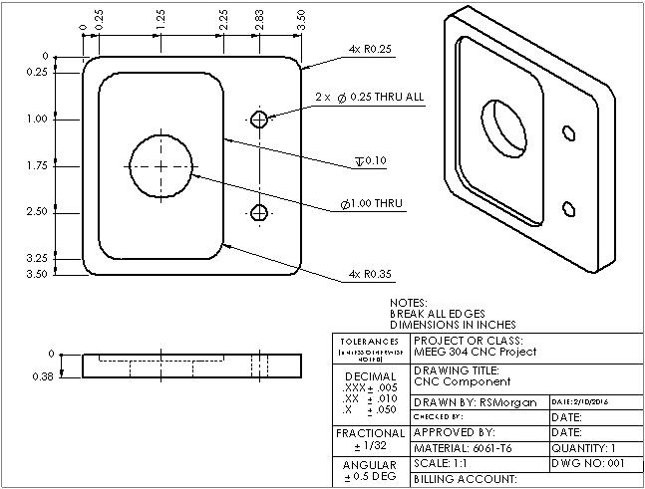

Slide 6
Speeds and Feeds Comparison
Trak 2-axis k3 Mill
Mazak VCU-500C 3-axis
.5” endmill 1200 rpm / 157 SFM 4 IPM feed
.25” endmill 1200 rpm /78 SFM 4 IPM feed
.5” endmill 12000 rpm /1565 SFM 120 IPM feed
.25” endmill 12000 rpm /785 SFM 84 IPM feed
3.0” facemill 6000 rpm / 4664 SFM 360 IPM feed
1.0” endmill 9500 rpm / 2505 SFM 631 IPM feed

Slide 7
The Next Step
Introduction to CAD/CAM

